Slide 1
Status Report
2015. 11. 18
Nam Jong Woo

Slide 2

Action Item
Dimuon plots (pT>25GeV, |$η$|<2.4)
Dimuon pT, eta, invariant mass
Include Ratio plot
M60to120

Slide 3
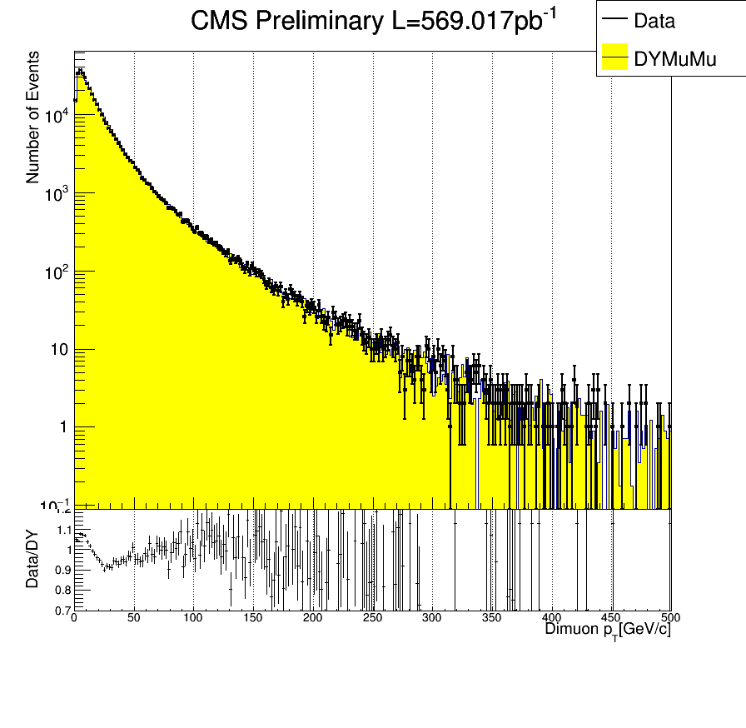
Dimuon pT

Slide 4
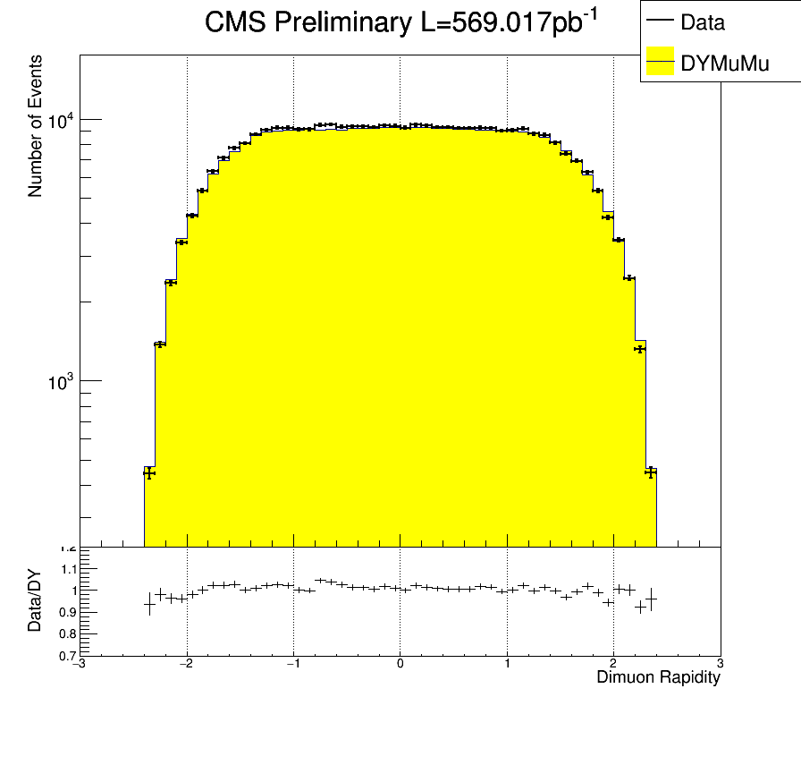
Dimuon Rapidity

Slide 5
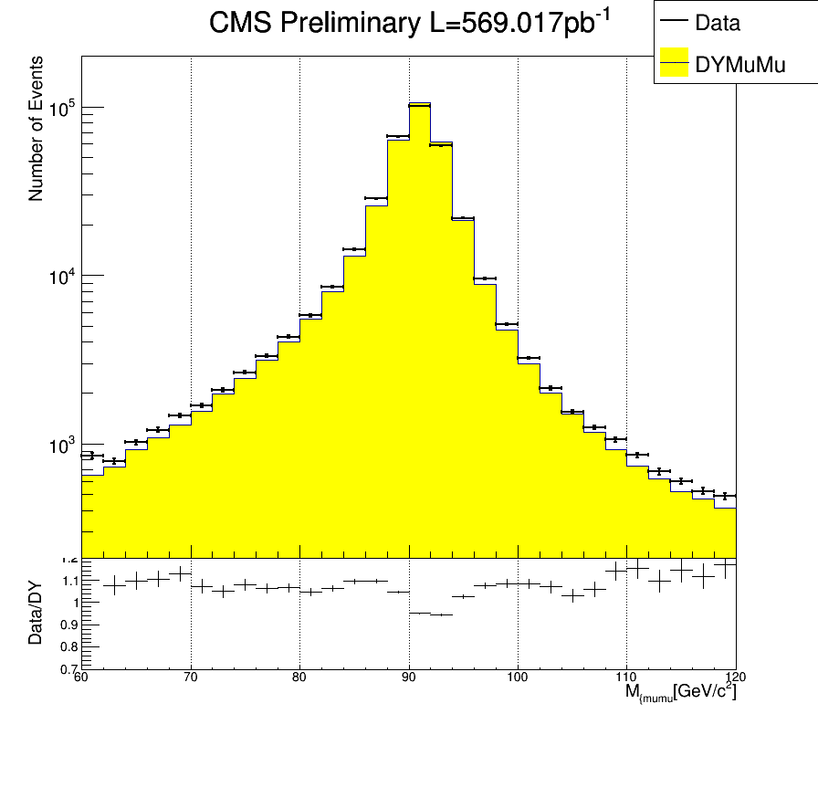
Dimuon Invariant mass

